Slide 1
Predicting Player Performance for Daily Fantasy
NBA on DraftKings
J. Chen, P. Wang, R. Ho

Slide 2
NBA on DraftKings: Fantasy Points
SCORING RULES
Players will accumulate points as follows:
Point = +1 PT
Made 3pt. shot = +0.5 PTs
Rebound = +1.25 PTs
Assist = +1.5 PTs
Steal = +2 PTs
Block = +2 PTs
Turnover = -0.5 PTs
Double-Double = +1.5PTs (MAX 1 PER PLAYER: Points, Rebounds, Assists, Blocks, Steals)
Triple-Double = +3PTs (MAX 1 PER PLAYER: Points, Rebounds, Assists, Blocks, Steals)

Slide 3
NBA on DraftKings: Constraints
ROSTER REQUIREMENTS
Rosters will consist of 8 players and must include players from at least 2 different NBA teams, and representing at least 2 different real-life NBA games.
The 8 roster positions are: PG, SG, SF, PF, C, G, F, and UTIL.
SALARY RULES
In each contest, participants will create a lineup by selecting players listed in the Player Pool. Each player listed has an assigned salary and a valid lineup must not exceed the salary cap of $50,000.

Slide 4
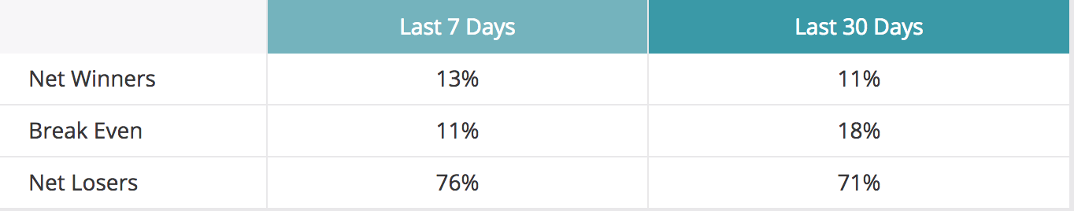
DraftKings: User Statistics

Slide 5
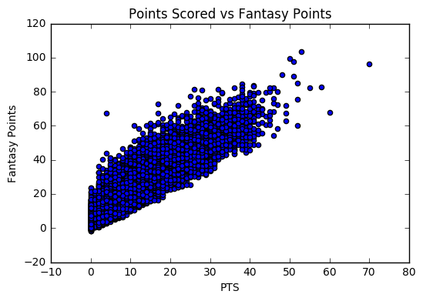
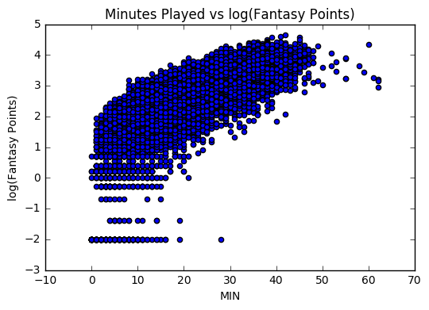
Basic EDA: Real Time Stats to Fantasy Points

Slide 6
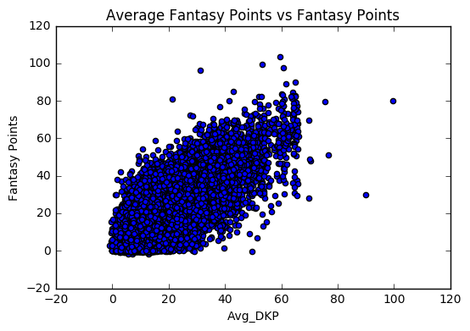
Feature Engineering
Cannot use real time stats
Need to create features based on past games
Incorporate team and opponent stats

Slide 7
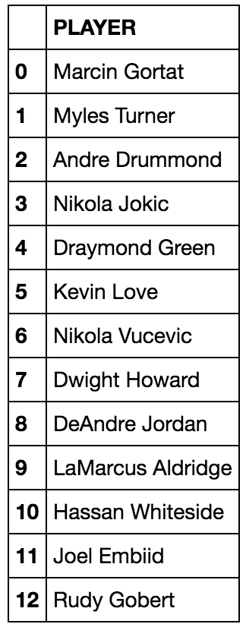
Grouping Players: K-means
Not enough data points in a single season for a specific player to create models for each player
Clustered similar players together based on their season averages

Slide 8
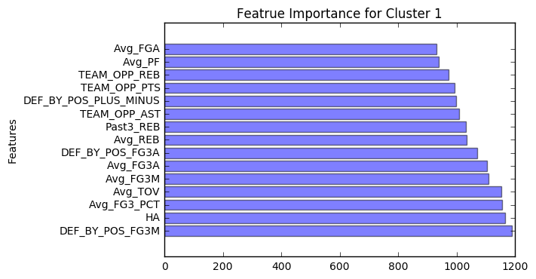
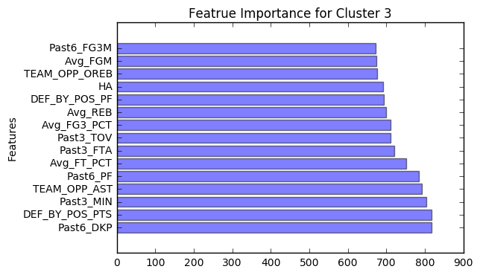
Prediction Model: xgboost

Slide 9
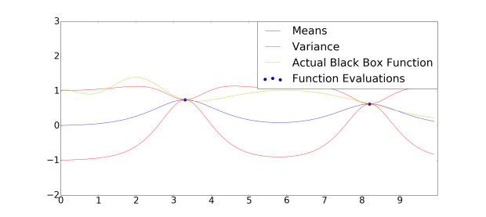
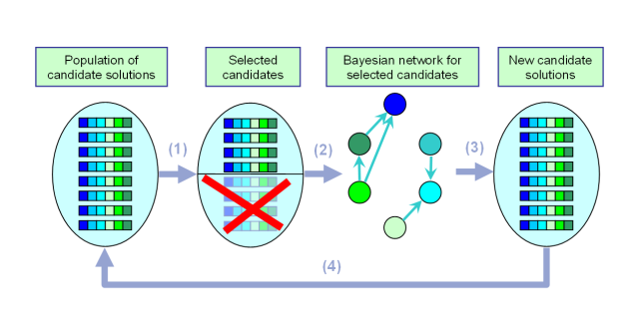
Model Tuning
Bayesian Optimization

Slide 10
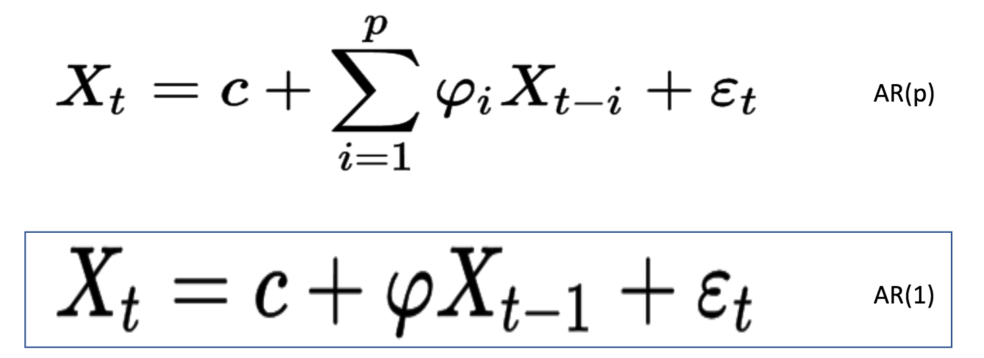
Time Series Model 1: Simple AR(1) Model
We chose AR(1) to keep the model simple (Too little observations so mo
We chose AR(1) to keep the model simple (Too little observations so more complicated models won’t do as well)
Most players have about 20-30 observations
X_t = DKP_t (Draft King Points at time t)

Slide 11
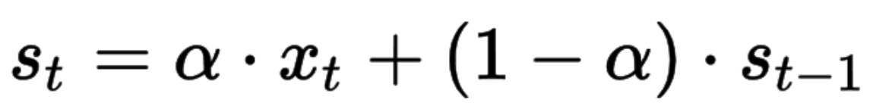
Time Series Model 2: Exponentially Weighted MA
X_t = DKP at time t
S_t = Forecasted value for time t
Alpha is the smoothing factor and between 0 and 1
Small alpha => More smoothing effect => Less responsive to recent changes
Large alpha => Less smoothing => More responsive
We chose alpha = 0.95

Slide 12
Player Volatility
Player’s minutes can vary greatly depending on the injury or playing status of their teammates
Scale their score to according to the minutes we believe they will get when a teammate sits out
Scale their score if they are coming back from a long injury
Scale their score based on a weight related to the overall volatility of their performance

Slide 13
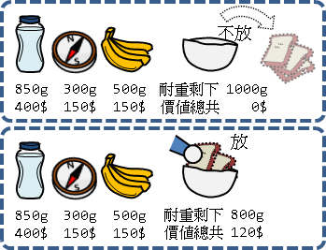
Knapsack Problem: Selecting a Lineup

Slide 14
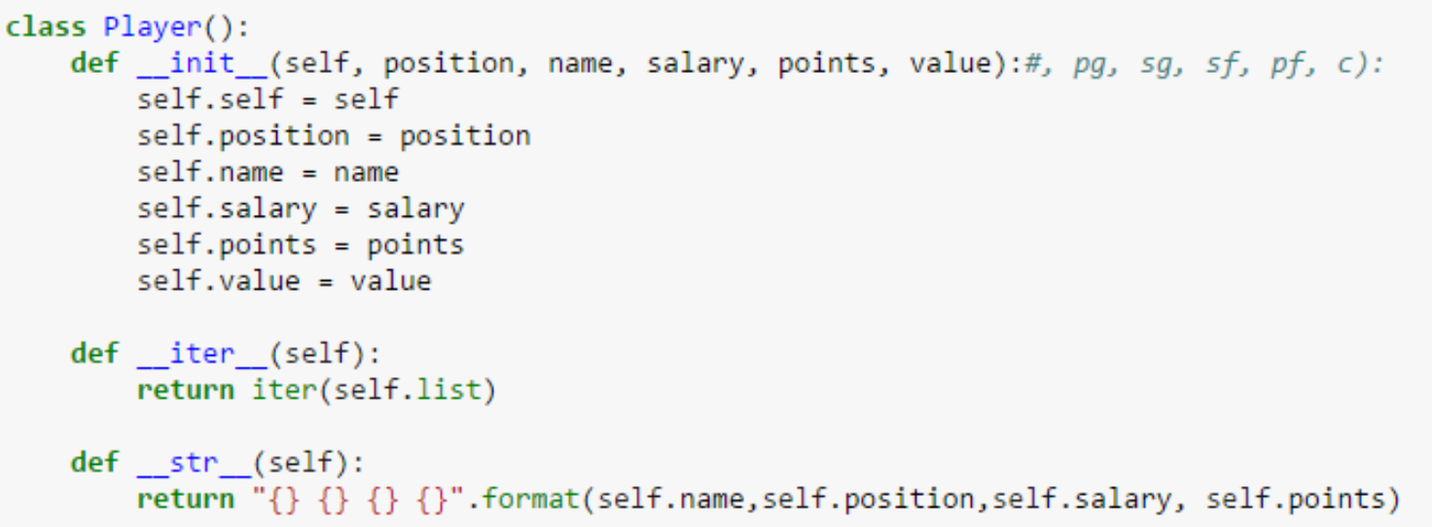
Greedy Algorithm
Define a class of players
Set the limit of positions and of budget
Limit not reached => Include the available player with the largest points
Points here are the estimated points using two TS models
Second model (EWMA) performed slightly better for recent games

Slide 15
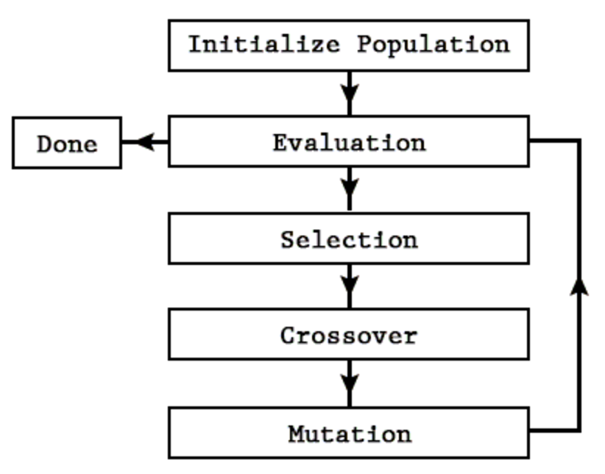
Genetic Algorithm

Slide 16
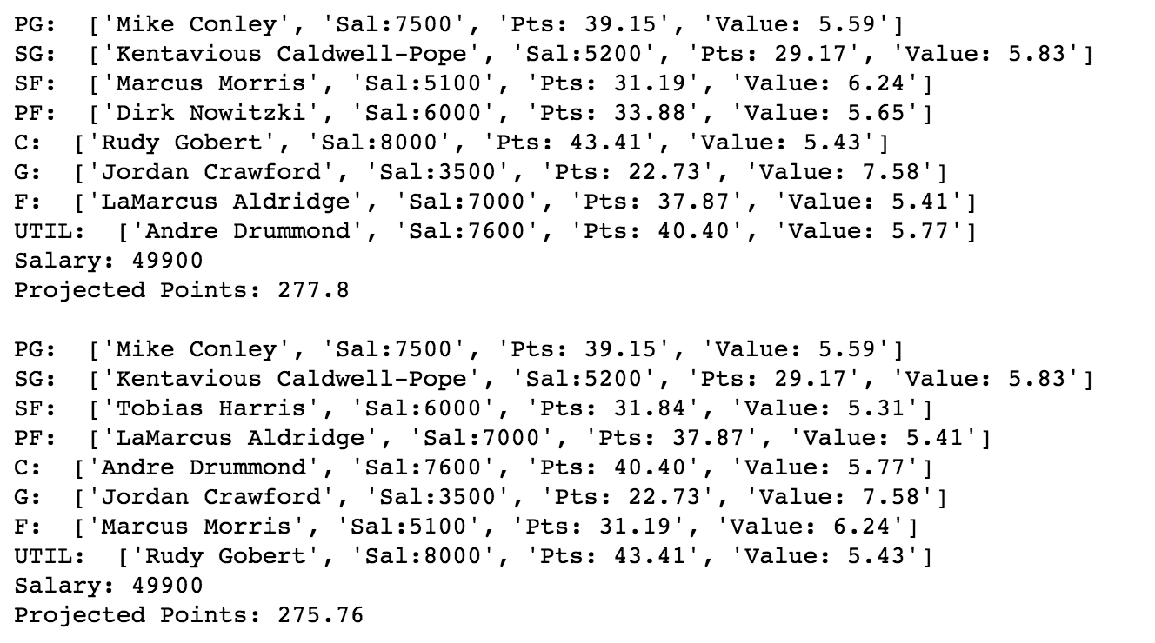
Knapsack Problem: Selecting a Lineup
Example Lineups:

Slide 17
Web App: Name in Progress
Live Demo
[Place Pic Here]

Slide 18
Future Work
Make predictions applicable to other daily fantasy games
Advanced Features
Incorporate and create more advanced stats
Include features not directly related to the game (player and team news)
Incorporate more models
Recommendation system?
Testing and Tuning
Improve web app
Make front end design more aesthetically pleasing
Have the data automatically update daily on a server

